Slide 1
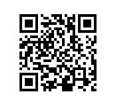
Ohio’s Next Generation Assessments and New Learning Standards - Meeting the Needs of Diverse Learners
Pupil Services Directors Meeting
Dec. 13, 2013
Notes:
When using this presentation - please credit Char Shryock, Bay Village City Schools.

Slide 2

Char Shryock
Director of Curriculum and Instruction
Bay Village City Schools
Ohio Education Leader Cadre
char.shryock@bayschoolsohio.org
Twitter @edtechgirl #PARCCELC, #ohedchat
http://iteachbay.blogspot.com
Notes:
INSERT YOUR CONTACT INFO HERE

Slide 3
PARCC Update
Understanding PARCC’s Role In Ohio’s Next Generation Assessments

Slide 4
PARCC’s Fundamental Advance
PARCC is designed to reward quality instruction aligned to the Standards, so the assessment is worthy of preparation rather than a distraction from good work.
Notes:
This is an important advance- the current OAA and OGT tests don't assess ALL the standards at a grade level - nor do they accurately assess what the standards really expect the student to do - the new standards are more rigorous - need to have assessments that teachers know will be matched to the standards they are teaching. So...it is important to start making the shift to Ohio's New Learning standards now - paying attention to the level of rigor expected in the standards.

Slide 5

Show me the EVIDENCE
Think of examples of why EVIDENCE is such a relevant word in education today.
Notes:
Use this to activate prior knowledge in session participants. Get them thinking about all the initiatives going on in education. Ideas - have participants work in a group to think of as many examples of evidence as they can. Relate evidence to specific content area standards. Have a discussion around what consititutes viable evidence.

Slide 6
Evidence Centered Design can inform a deliberate and systematic approach to instruction that will help to ensure daily classroom work leads to all students meeting Ohio's New Learning Standards.
Notes:
Share this quote - focus on INFORM, DELIBERATE and SYSTEMATIC

Slide 7
Evidence-Centered Design (ECD) in the Classroom - Start with the end in mind.
PARCC is using ECD to create the gr 3-11 assessments.
Learning Targets/Objectives
Classroom Assessments Formative/Summative
Design begins with the inferences (claims) we want to make about students—should be connected clearly to Ohio's New Learning Standards - What should students be able to DO or KNOW?
Classroom Activities
In order to support claims, we must gather evidence----what can teachers point to, underline or highlight to show that students are making progress toward doing what we claim they can do?
Classroom activities (tasks) are designed to elicit specific evidence from students in support of claims.
Notes:
This is an important slide - it helps teachers see how they can use evidence centered design in their own assessment planning - this is where you can make a connection between the process PARCC is using - and what they could do to write SLOs, common assessments, design units aligned to the New Learning standards, etc.
Approach to assessment provides clear connection between the Standards and the inferences we want to draw about students (claims), the type of student work/demonstrations that allow us to draw those inferences, and the tasks or activities that allow us to elicit that student work.
This same approach/concept applies in the classroom—with ideas like Understanding By Design—moving backwards from the Standards to Classroom Assessments.

Slide 8
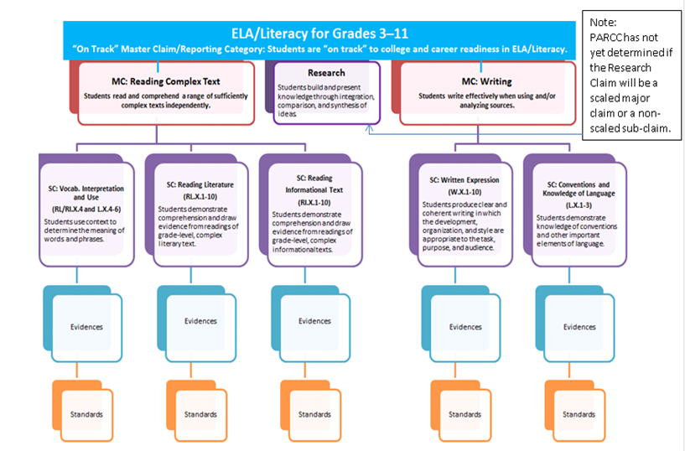
Understanding the Claims
Notes:
This is the PARCC Claims diagram. Focus on the Master Claims - since they are reflected in ALL content areas - not just ELA. Notice the balance between literature and informational text. Point out the vocab in context subclaim - since there is a protoype question that can be used to show ECD as it relates to this subclaim.

Slide 9
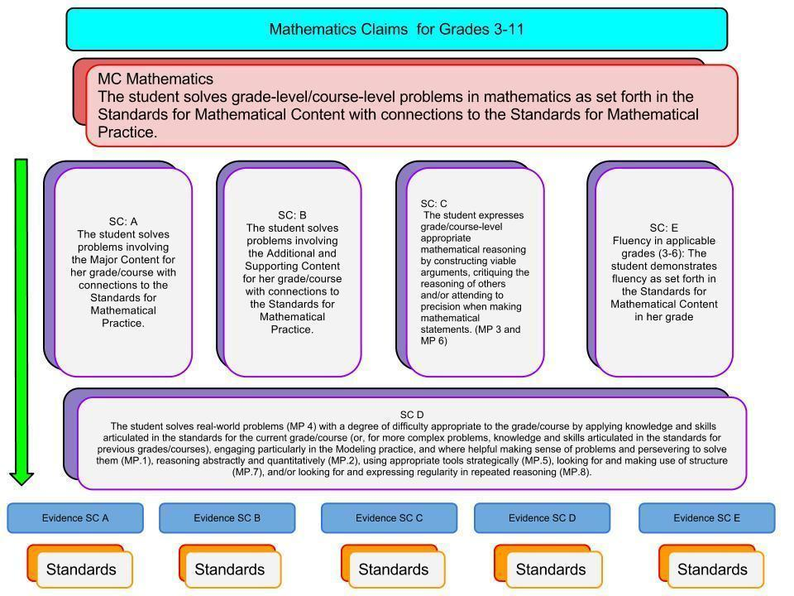
Notes:
These are the PARCC Math Claims - I like to look at subclaim D - since it ties in the mathematical practices and there are prototype questions that can be used to show how this subclaim works with ECD.

Slide 10
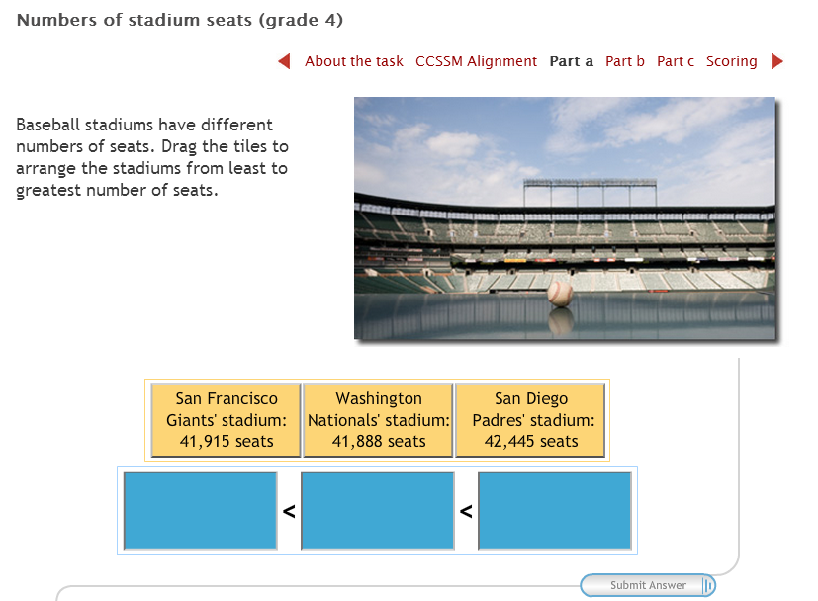
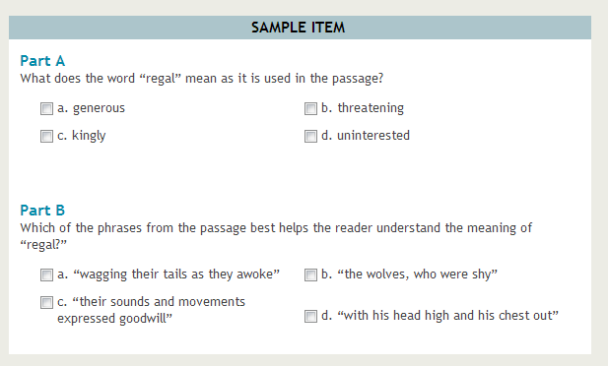
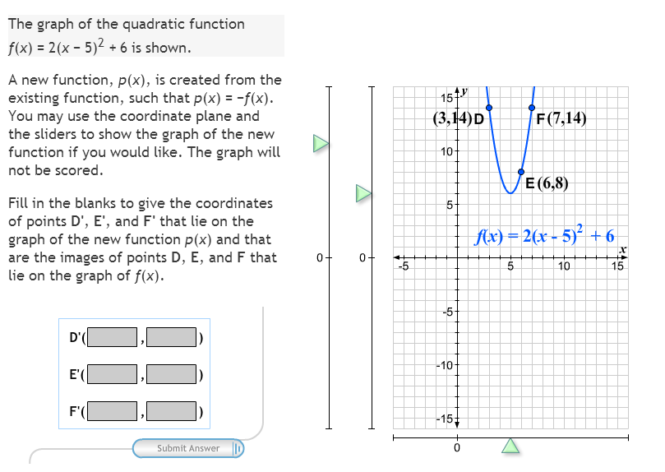
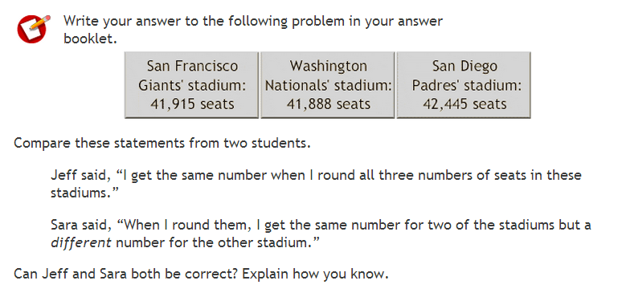
Prototype Questions
Notes:
These prototypes tie back to the claims in ELA and Math and are good to illustrate how the ECD process is being used to develop assessment items. They are hyplinks - so clicking on the picture will take you to the website. I like to show the vocab item It is a gr 6 ELA prototype and is a good example of how to write an assessment item that will colllect EVIDENCE to support a CLAIM. Traditional vocab questions stop with part A - which would not collect evidence that a student can really use vocab in context. By adding part B - now you are collecting this evidence.

Slide 11
PARCC Assessment 101
ELA Performance Based Assessment (PBA)
Research Simulation Task
Literary Analysis Task
Narrative Task
  Read Multiple Texts
  Focus on comprehension using vocab and short answer questions
  Write an evidence based essay
ELA End of Year Exam (EOY)
Include 4-5 texts both Info and Literary
  Short answer comprehension questions
  Vocabulary questions
  Info text will be science, social studies,technical

Slide 12
PARCC Assessment 101
Math Performance Based Assessment (PBA)
Short Response
Extended Response
  Focus on mathematical practices
  applications of skills and practices to solve problems focusing on modeling, reasoning and precision.
Math End of Year Exams (EOY)
Short answer questions
  Focus on conceptual understanding
  Focus on procedural skills
  Focus on application

Slide 13
Performance Level Descriptors
PARCC will report students achievement using PLDs and scaled scores.
In October 2012 PARCC established 5 performance levels
  Level 5: Students performing at this level demonstrate a distinguished command of the knowledge, skills, and practices embodied by the Common Core State Standards assessed at their grade level.
  Level 4: Solid command…
  Level 3: Moderate command…
  Level 2: Partial command…
  Level 1: Minimal command…
  Cut Scores will be determined in the Summer of 2015 using multiple stakeholders in the decision making process.
Notes:
These are the performance level descriptor categories that will be used on the Ohio Next Generation Assessments. 4 is considered a "mastery" score 1-3 would indicate student may need additional learning and/or supports.
PARCC Governing Board and Advisory Committee on College Readiness vote in October 2012 established 5 performance levels
Level 5: Students performing at this level demonstrate a distinguished command of the knowledge, skills, and practices embodied by the Common Core State Standards assessed at their grade level.
Level 4: Solid command…
Level 3: Moderate command…
Level 2: Partial command…
Level 1: Minimal command…
Policy-level PLDs serve as a foundation for grade- and subject-specific performance level descriptors

Slide 14
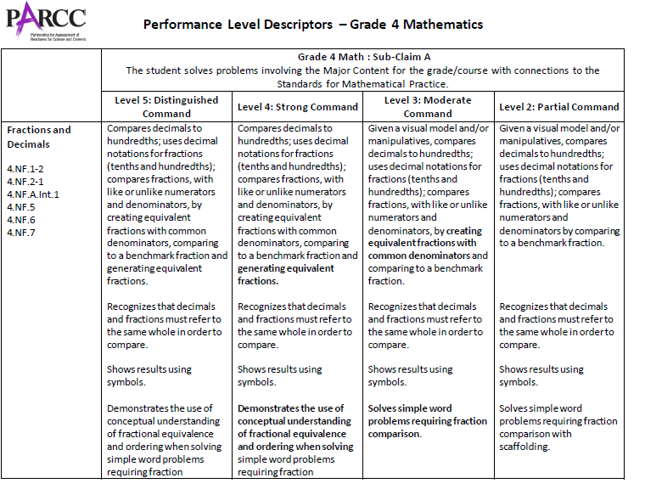
Looking at the PLDs
Gives the PLD by performance level ranging from 2-5. Level 1 indicates a range from no work shown to Minimal command
Gives the Sub-Claim that the PLD is written for
(A-Major Content)
Gives the Conceptual Concept the PLD is based on
Notes:
This is a Grade 4 PLD for Sub-Claim A. It focuses on content within “Numbers and Operations – Fractions”.

Slide 15
Communicating Around Ohio’s Next Generation Assessments and New Learning Standards.
Closing Information Gaps - Teachers, Parents, Community Members

Slide 16
Ohio’s New Learning Standards
English, Math - from CCSS with input from OH Teachers
Science, Social Studies, Physical Education, Fine Arts and World Languages - Ohio Developed
What you need to know:
Building a “Toolkit” of Knowledge to make sure students will have choices when they graduate from HS
Age appropriate
Aligned across grade levels
Focus on deeper understanding and real world applications of knowledge.
All students have access to challenging material
Focus is on content knowledge AND problem solving, perseverance, supporting opinions and ideas with evidence, modeling, reading and writing, speaking and listening skills.

Slide 17
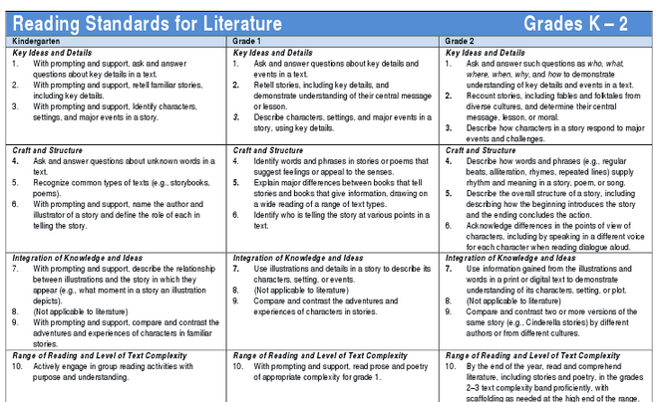
Ohio Academic Content Standards - Extended
Grade Level Standards - By Band

Slide 18
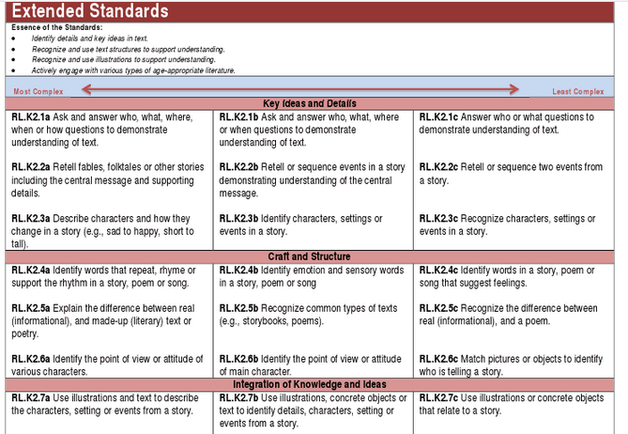
Ohio Academic Content Standards - Extended
Grade Level Standards - By Entry Point

Slide 19
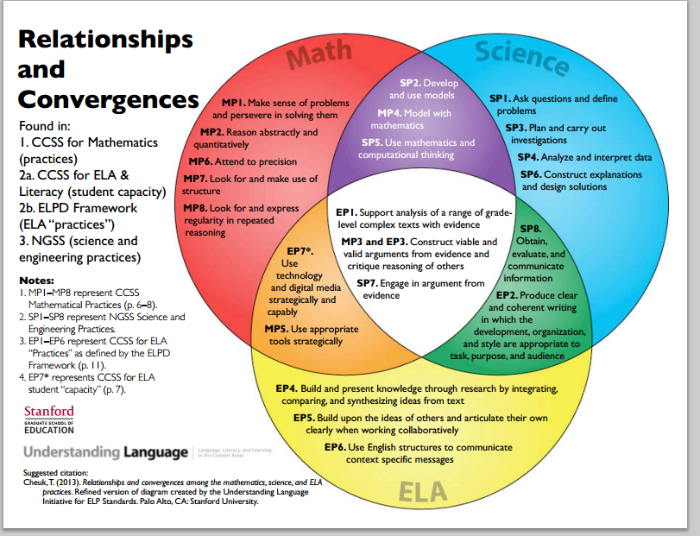

Slide 20

Achievethecore.org

Slide 21
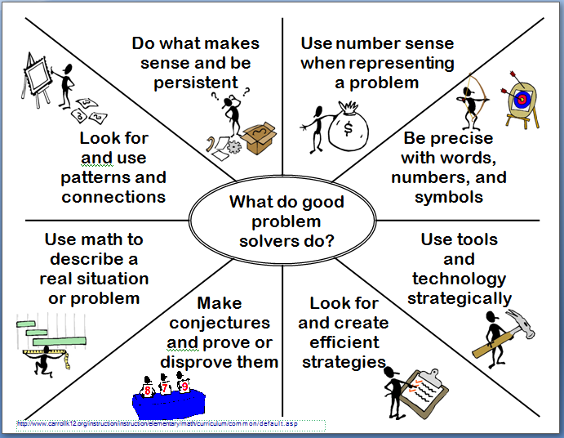
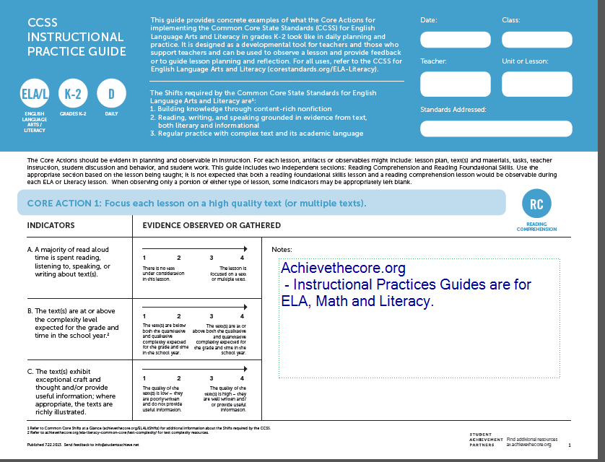

Slide 22


Slide 23
All teachers are teachers of language. The language of math, science, social studies, art, business, physical education. If your students are not fluent in your "language" they will not be able to understand your content at a deeper level.
Notes:
This connects the CCSS ELA Appendix A to the instructional shifts - there are reading and writing standards that cross all curriculums and grade levels. Instead of telling people they are reading teachers - we want them to become language teachers. -

Slide 24
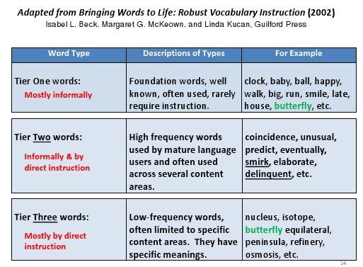

Slide 25
Stanford Research on ELL - Can Help Us Support Our Developing Readers
Differentiate within the ELA Literacy standards by looking at levels of analyses of complex texts. Develop formative assessments around:
  Analytical Task Expectations
  Receptive Language Functions
  Productive Language Functions
Helping students to "decode" learning target verbs - by paying attention to the language conventions tied to the verb.
Notes:
This slide is referencing the ELL white paper from Stanford - very helpful as a tool for all teachers to look at how to support students who are having a hard time accessing the "language" of their content area. https://docs.google.com/file/d/0B9B3v9o2K7IlMVpwMTY5UVdIZHM/edit

Slide 26
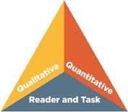
CCSS and Literacy
Text Complexity
  Qualitative - levels of meaning or purpose, text structure, language clarity, knowledge demands. (reader measured)
  Quantitative - word length, sentence length,text cohesion. (machine measured)
  Matches Reader to Task - reader motivation, reader knowledge level, reader experiences, and purpose and complexity of the task. (teacher measured)

Slide 27

CCSS and Literacy
Writing
  Argument - change readers point of view, promote reader to take action or convince reader to believe explanation of issues or problems.
  Informational/Explanatory Writing - conveys accurate information to build reader understanding or comprehension of a topic.
  Narrative Writing - shares real or imagined experiences. Has multiple purposes.

Slide 28

CCSS and Literacy
Vocabulary
  Students need to have repeated exposure to content vocabulary in a variety of contexts in order to master the vocabular.
  Tier 2 Words - general academic words that are found across multiple content areas.
  Tier 3 Words - domain specific words - or academic words that have a unique meaning in a specific content area. Usually need to be defined by the text or the teacher. Students need to know these to "unlock" the content.

Slide 29
What is DIFFERENT about Common Core Vocabulary Instruction.
Traditional - Memorize lists. Use words in sentences. Look up words, copy definition. Study on words and definitions using flashcards.
Common Core - Understand and recognize words in context. Use the words to make sense of reading. Look at word relationships and build meaning from using context clues and background knowledge. Use words to communicate effectively.

Slide 30


Slide 31
Making The Shift - Literacy
How are lessons focusing on helping students to acquire vocabulary...in context...in all content areas?
How are a variety of fiction, non-fiction materials and primary source materials that create a continuum of complex texts for student reading be used...in all content areas?
What strategies/tools are available to help students build and organize knowledge...in all content areas?
How are engaging writing prompts that allow students to write persuasively or support an argument being used...in all content areas?
What opportunities are there to go back into the reading materials to find information to support a discussion...in all content areas?
What opportunities to work with a group to build reading comprehension by listening to and commenting on the arguments and reflections of others are included...in all content areas?

Slide 32

EQuIP/Quality Rubric - Ohio
Rubrics will be used to evaluate exemplar unit plans shared through the ODE website
Rubrics will be available to teachers and teacher teams to use when planning lessons/ units.
Math,Science, Social Studies, ELA
Notes:
The purpose of these documents is not EVALUATIVE but more "REMODELING and REDESIGNING" talking points for teachers teams who are working to align materials to ONLS. Suggest starting with a neutral unit - maybe something downloaded from the illuminations or readwritethink website as the first use of the rubric - then move to units the teachers know need work - then finally apply it to their favorite lessons.

Slide 33
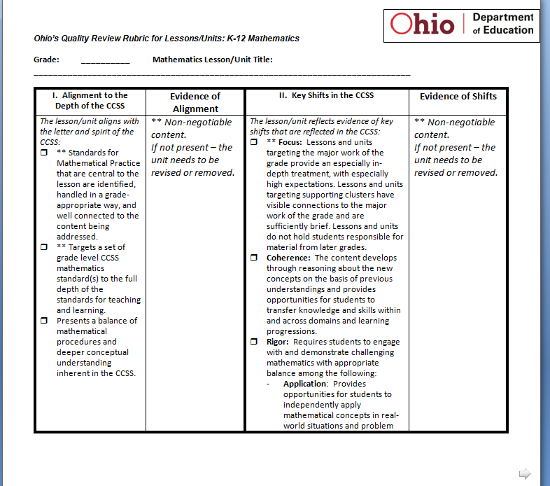
Notes:
This slide and the next slide are screen captures of one of the Quality Rubrics - just to give teachers an idea of the 4 categories. There are some consistent items that appear on all of the rubrics.

Slide 34
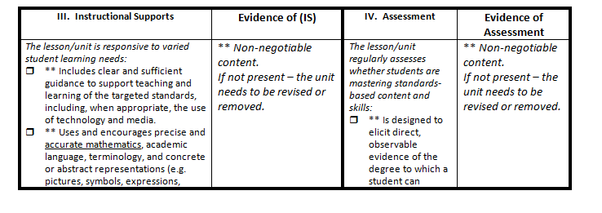

Slide 35

Communicating to Parents
Most interested in assurance that their students are learning what they need to know to be successful in college or careers as they grow into adulthood, how much it will cost them in increased student fees or tech costs, how students will be assessed, how teachers will communicate learning progress, what they can do at home to support students, how will classroom technology be used safely and equitably.
PTA Parent Guides for ELA/Literacy and Math
PARCC Accommodations Guide For Parents
ODE Parent Portal
Provide District Updates on Curriculum Alignment
Provide District Updates on Technology Readiness

Slide 36
Communicating To BOE and Community
BOE Members - costs to the district and state, how to budget for teacher training, curriculum changes and technology upgrades, how to balance/respond to opposing viewpoints around adopting the standards, setting aggressive but achievable timelines for implementation, how to increase accountability for student learning - teachers and administrators.
Community Members -most interested in cost to the community, maintaining local control over curriculum decisions, supporting a quality educational system to keep home values up, schools preparing students to be active members of the community.
NSPRA Common Core Communications Network
BASA Updates
Twitter Chats - #ohedchat Tues. 9:00 #oheducation, #PARCC
Provide Regular District Updates

Slide 37
PARCC Accommodations

Slide 38
Goals For Promoting Student Access
Using Universal Design principles during every stage of the development process.
Minimizing/eliminating features that are irrelevant to what is being measured so all students can accurately demonstrate their knowledge and skills.
Measuring the full range of complexity of the standards.
Leveraging technology for the accessible delivery of assessment.
Building accessibility throughout the test itself without sacrificing assessment validity.
Using a combination of ‘accessible’-authoring and accessible technologies from the inception of items and tasks.
Engaging state and national experts throughout the development process through item review, bias and sensitivity review, policy development and review, and research.

Slide 39
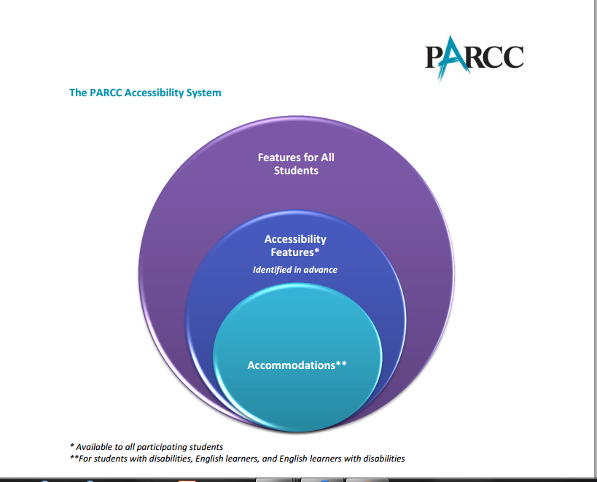

Slide 40
Accessibility Features for All Students
Accessibility Features for All Students
Audio Amplification
Blank Paper - math or ELA (provided by test administrator)
Eliminate Answer Choices
Flag Items for Review
General Administration Directions Clarified (by test administrator)
General Administration Directions Read Aloud and Repeated (by test administrator)
Highlight Tool
Headphones
Magnification/Enlargement Device (up to 400%)
NotePad
Pop-Up Glossary
Redirect Student to Test (by test administrator)
Spell Checker
Writing Tools - bullets, cut, copy,paste, underline,bold

Slide 41
Testing Site Accommodations
Based on the PARCC Test Administration Manual the following can be made available to any students based on building admin decision.
Small group testing
Frequent breaks
Time of day
Separate or alternate location
Specified area or seating
Adaptive and specialized equipment or furniture

Slide 42


Proposed
Accommodations for Students with Disabilities and ELL Students

Slide 43
Universal Design Principles
“It is important to ensure that performance in the classroom and on the assessment is influenced as little as possible by a student’s disability or linguistic/cultural characteristics that are unrelated to the content being assessed.”
Provide equitable access during instruction and assessments
Mitigate the effects of a student’s disability
Do not reduce learning or achievement expectations
Do not change the construct being assessed
Do not compromise the integrity or validity of the assessment

Slide 44
Who Can Receive Accommodations?
Students with disabilities who have an Individualized Education Program (IEP)
Students with a Section 504 plan who have a physical or mental impairment that substantially limits one or more major life activities, have a record of such an impairment, or are regarded as having such an impairment, but who do not qualify for special education services
Students who are English learners
Students who are English learners and with disabilities who have an IEP or 504 plan. These students are eligible for both accommodations for students with disabilities and English learners.

Slide 45
Accommodations Identified In Advance
Students and Teachers can select accessibility features ahead of time
  based on their needs and preferences
  must practice using them, either in a classroom setting or in real world application.
Tools will be turned on for the selected students
  ex. changing background color
  ex. changing font color
  ex. using on screen reader for math

Slide 46
Personal Needs Profiles (PNPs)
Will be embedded in the test platform
Will be created by IEP, IAT or Teacher Team for students with disabilities or ELL students.
Will be created by Teacher Teams, with input from the parent, for students who have not been identified with a specific disability or who are not ELL but have specific educational needs identified by the team.
Additional details will be in the Administration Manual

Slide 47
Accessibility Features Identified in Advance On PNPs
Accessibility Features Identified in Advance
Answer Masking
Background/Font Color (Color Contrast)
General Masking
Line Reader Tool
Text-to-Speech for the Mathematics Assessments

Slide 48
Factors To Consider When Developing PNPs
Factor 1: Student characteristics and learning needs (e.g., disabilities, language proficiency, accommodations used in classroom instruction/assessments to access and perform in academic standards and State tests)
Factor 2: Individual test characteristics (i.e., knowledge about what tasks are required on PARCC assessments and ways to remove physical and other barriers to students’ ability to perform those tasks)
Factor 3: PARCC accommodations policies that maintain the validity of assessment results.

Slide 49
Presentation Accommodations - Must be identified in advance on a PNP
Content Area | Presentation Accommodations
ELA/Literacy | Text-to-Speech or Video of a Human Interpreter for the ELA/Literacy Assessments, including items, response options, and passages*
 | Braille Edition of ELA/Literacy Assessments (Hard-copy braille tests and refreshable braille displays for ELA/Literacy)
 | Closed-Captioning of Multimedia Passages on the ELA/Literacy Assessments
 | Descriptive Video
Mathematics | Video of a Human Interpreter for the Mathematics Assessments for a Student Who is Deaf or Hard of Hearing
 | Braille Edition of Mathematics Assessments (Hard-copy braille tests for Mathematics)
Both Content Areas | Additional Assistive Technology (Guidelines available fall 2013)
 | Tactile Graphics
 | Video of a Human Interpreter for Test Directions for a Student Who is Deaf or Hard of Hearing
 | Paper-and-Pencil Edition
* See notes below
Notes:
*Text-to-Speech for ELA/Literacy:
The accommodation is intended to provide access to printed or written texts in the PARCC ELA/Literacy assessments to a very small number of students with disabilities who would otherwise be unable to participate in the assessment without the use of text-to-speech technology, human reader (paper-and-pencil test only), or embedded video of a human interpreter providing ASL.
Note: If headphones are not used, the student must be tested in a separate setting.
IEP or 504 plan teams may consider providing this accommodation to a student who has a print-related disability that severely limits or prevents his or her ability to access printed text by decoding, or who is blind and is unable to access braille to read text. This accommodation is not intended for students reading somewhat (i.e., moderately) below grade level.
Guidelines are provided below for IEP and 504 Teams to identify students to receive this accommodation:
In making decisions whether to provide the student with this accommodation, IEP and 504 teams are instructed to consider whether the student has:
Blindness or a visual impairment and has not learned (or is unable to use) braille;
OR
A disability that severely limits or prevents him/her from accessing printed text, even after varied and repeated attempts to teach the student to do so (e.g., student is unable to decode printed text or read fluently);
OR
Deafness or a hearing impairment and is severely limited or prevented from decoding text due to a documented history of early and prolonged language deprivation
Before listing the accommodation in the student’s IEP or 504 plan, teams should also consider whether:
The student has access to printed text during routine instruction through a reader or other spoken-text audio format;
The student’s inability to decode printed text or read braille is documented in evaluation summaries from locally-administered, diagnostic assessments;
The student receives ongoing, intensive instruction and/or interventions in the foundational reading skills to continue to attain the important college and career-ready skill of independent reading.
For administration guidance, refer to Appendices A and B, which will be provided in a future manual edition. For audio guidelines please refer to Appendix J.
Reporting Notation to Schools and Parents:
A notation will be provided on all confidential score reports to the school and parent stating that the student was given a reading access accommodation on the PARCC ELA/Literacy assessment, and therefore, no claims should be inferred regarding the student’s ability to demonstrate foundational print reading skills (i.e., decoding and fluency).
Reporting Notation for LEAs and SEAs:
While the decisions about who gets this accommodation will be up to the IEP/504 teams, PARCC will collect and report data about the use of this accommodation.

Slide 50
Response Accommodations
Content Area | Response Accommodations
ELA/Literacy | Scribing or Speech-to-Text (i.e., Dictation/Transcription or Signing) for constructed responses on the English Language Arts/Literacy Assessments*
 | Word prediction on the ELA/Literacy Performance-Based Assessment*
Mathematics | Calculation Device and Mathematics Tools* (on Non-calculator Sessions of Mathematics Assessments)
Both Content Areas | Additional Assistive Technology (Guidelines available fall 2013)
 | Braille note-taker
 | Scribing or Speech-to-Text (i.e., Dictation/Transcription or Signing) for the Mathematics assessments, and for selected response items on the English Language Arts/Literacy assessments
* See notes below
Notes:
*Scribing or Speech-to-Text (i.e., Dictation/Transcription or Signing) for constructed responses on the English Language Arts/Literacy Assessments
The student dictates responses either verbally, using a speech-to-text device, augmentative/ assistive communication device (e.g., picture/word board), or by signing, gesturing, pointing, or eye-gazing. The student must be tested in a separate setting. Grammar checker, Internet, and stored files functionalities must be turned off. Word prediction may also need to be turned off for students who do not receive this accommodation.
In making decisions whether to provide the student with this accommodation, IEP and 504 teams are instructed to consider whether the student has:
A physical disability that severely limits or prevents the student’s motor process of writing through keyboarding;
OR
A disability that severely limits or prevents the student from expressing written language, even after varied and repeated attempts to teach the student to do so.
Before listing the accommodation in the student’s IEP/504 plan, teams should also consider whether:
The student’s inability to express in written form is documented in evaluation summaries from locally-administered diagnostic assessments.
The student should receive ongoing, intensive instruction and/or interventions to learn written expression, as deemed appropriate by the IEP/504 team.
Reporting Notation to Schools and Parents:
A notation will be provided on all confidential score reports to the school and parent stating that the student was provided a scribe accommodation on the PARCC ELA/Literacy assessment, and therefore, no claims should be inferred regarding the student’s ability to demonstrate expressive writing skills. Ongoing instruction in the foundational skills may be needed to allow students to continue to attain the important college and career-ready skill of writing. Notations will not be provided for students who receive a scribe on the PARCC Mathematics assessment or for selected responses only on the ELA/Literacy assessment.
Note: Please refer to the PARCC Scribe Guidelines in the PARCC Test Administration Manual for administration information.
*Word prediction on the ELA/Literacy Performance-Based Assessment
The student uses word prediction software that provides a bank of frequently- or recently-used words onscreen as a result of the student entering the first few letters of a word.
In making decisions whether to provide the student with this accommodation, IEP and 504 teams are instructed to consider whether the student has:
A physical disability that severely limits or prevents the student from writing or keyboarding responses;
OR
A disability that severely limits or prevents the student from recalling, processing, and expressing written language, even after varied and repeated attempts to teach the student to do so.
Before listing the accommodation in the student’s IEP/504 plan, teams are instructed to consider whether:
The student’s inability to express in writing is documented in evaluation summaries from locally administered diagnostic assessments.
The student should receive ongoing, intensive instruction, and/or intervention in language processing and/or recall, as deemed appropriate by the IEP/504 plan team.
*Calculation Device & Mathematics Tools:
The student uses a calculation device (e.g., four-function calculator, large key or other adapted calculator), an arithmetic table (including addition/ subtraction and/or multiplication/division charts), and/or manipulatives (IEP or 504 plan must specify which one) on the non-calculator session of the Mathematics test. If a talking calculator is used, the student must use headphones or test in a separate setting.
Students with visual impairments may need other mathematical tools such as a large print ruler, braille ruler, tactile compass or braille protractor.
For students with a disability that severely limits or prevents their ability to perform basic calculations (i.e., addition, subtraction, multiplication or division), this accommodation allows a calculation device to be used on non-calculator Mathematics assessment sessions. The accommodation would be permitted on test sessions for which calculators are not allowed for other students, with the exception of mathematics fluency items/tasks in grades 3-6 for which no calculation device may be used. If a calculation device were used for those test items that exclusively measure calculation skills, the validity of the test claim (Sub Claim E – Mathematics fluency in grades 3-6: The student demonstrates fluency as set forth in the Standards for Mathematical Content) would be compromised, and the score invalid.
Guidelines are provided below for IEP and 504 teams to identify students to receive the accommodation of a calculation device on non-calculator sessions of the PARCC Mathematics assessments:
In making decisions whether to provide the student with this accommodation, IEP and 504 teams should consider whether the student has:
A disability that severely limits or prevents the student’s ability to perform basis calculations (i.e., addition, subtraction, multiplication or division), even after varied and repeated attempts to teach the student to do so.
Before listing the accommodation in the student’s IEP/504 plan, teams should also consider whether:
The student is unable to perform calculations without the use of a calculation device, arithmetic table, or manipulative during routine instruction;
The student’s inability to perform mathematical calculations is documented in evaluation summaries from locally-administered diagnostic assessments.
The student should receive ongoing, intensive instruction and/or interventions to learn to calculate without using a calculation device, in order to ensure that the student continues to learn Mathematics fluency.

Slide 51
Other Proposed Accommodations for Students with Disabilities
Category | Accommodation
Timing & Scheduling | Extended Time
Setting | Many settings that were once considered accommodations are now consider accessibility features for all students and will be included in the test administrator manual. These include – separate location, small group testing, specified area or seating, time of day, and frequent breaks.
Notes:
NOTE: The “extended time” accommodation would allow a maximum of up to one school day to complete one test session during the prescribed testing window. Students who use this accommodation will need a quiet location in which to complete the test.

Slide 52
What about students who need accommodation not included in the manual?
“Students may require additional accommodations that are not found in the Presentation accommodations, or a student who does not have an IEP or 504 plan may require an accommodation as a result of a recently-occurring accident or illness. PARCC states will review requests for unique accommodations in their respective states on an individual basis and will provide approval after determining whether the accommodation would result in a valid score for the student, using guidelines comparable across PARCC states.”

Slide 53
Accommodations for English Learners
KEY for Table 5 below:
• Highly recommended for use by English learners at this English language proficiency level
◉ Recommended for use by English learners at this English language proficiency level
May not be appropriate for students at this ELP level
Accommodation | Beginning | Intermediate | Advanced
Extended Time | • | • | •
General Administration Directions Clarified in Student’s Native Language (by test administrator) | • | ◉
General Administration Directions Read Aloud and Repeated as Needed in Student’s Native Language (by test administrator) | • | ◉
Scribe or Speech-to-Text: Responses Dictated for Mathematics Assessment in English | • | ◉
Word-to-Word Dictionary (English/Native Language) |  | • | •
Notes:
Test administrators providing accommodations (General Administration Directions Clarified or Read Aloud in Student’s Native Language, Scribe) should be literate and fluent in English, as well as the student’s native language.

Slide 54
Non-allowable Accommodations
Requiring a student to be assessed on less content matter than other students because he has been taught less material
Reducing the scope of assessments so a student needs to complete only a limited number of problems or items
Modifying the complexity of assessments to make them easier (e.g., deleting half of the response choices on a multiple-choice test so that a student selects from two options instead of four);
Giving hints, clues, or other coaching that directs the student to correct responses on assignments and tests
Adults defining vocabulary on the test or explaining test items;
Allowing the student to complete an assessment of English language arts in a language other than English
Using dictionaries that provide definitions (rather than an acceptable word-to-word duallanguage dictionary)

Slide 55
Guiding Questions
What are the student’s learning strengths and challenges, and are these based on language needs, a disability, or both?
How do the student’s learning and/or language needs affect the achievement of grade level CCSS?
Which accommodations are regularly used by the student during instruction and assessments?
Which new accommodations, if any, would increase the student’s access to instruction and assessment by addressing the student’s learning needs and reducing the effects of the student’s disability?

Slide 56
More Questions
Should an existing accommodation be implemented differently?
What were the outcomes when accommodations were used and when they were not used during classroom assignments and on assessments?
What is the student’s perception of how well an accommodation “works”?
What difficulties did the student experience when using accommodations?
What are the perceptions of parents, teachers, and specialists about the effectiveness of accommodation?

Slide 57

Questions
Notes:
Make sure to have a Parking Lot for questions that either aren't directly related to the topic or questions you don't know the answer to - make sure to follow up on those questions.

